Slide 1
The Great State of Washington:
WA Datavision:
The Story of FHIR Saga
Session #215, March 6, 2025
Dr. Bryant T. Karras
Chief Medical Informatics Officer
Washington State Department of Health

Slide 2

Welcome

Slide 3

Welcome
Bryant Thomas Karras MD FACMI
University of Washington and WA State, Dept of HEALTH
Biomedical Engineer
Internal Medicine Physician
Epidemiologist
Public Health Informatician
2024 Change Maker and 2023 Davies Award winner

Slide 4
Conflict of Interest Slide
Bryant Thomas Karras MD FACMI
Has no real or apparent conflicts of interest to report.

Slide 5

WA Datavision: The Story of FHIR Saga
HIMSS25: March 6, 2025
Notes:
“It’s easy to come up with new ideas; the hard part is letting go of what worked for you two years ago but will soon be out of date.” —Roger von Oech

Slide 6
Agenda
Davies award 2023 Public Health
Washington Transformational Plan
WA DOH Data Modernization Initiative
FHIR roadmap
SMART on FHIR PDMP
WA HEALTH
VRDR
eCR
TEFCA
TRAX
RESP-NET
Birth Records & Newborn Screening
IPS/WA-PS
Advanced Directives/POLST
Notes:
Multi Cloud strategy: Azure AWS and Google (heard we cancelled google AI???) Unity Catalog, a unified governance solution for data and AI assets on Databricks lakehouse PostIT for R Studio FHIR Server AidBox + Rhapsody for 21st Century API capability and TEFCA interoperability Licensure HELMS on Salesforce adding MuleSoft to Rhapsody as duel architecture for message brokering

Slide 7

Agenda
Davies award 2023 Public Health
Washington Transformational Plan
WA DOH Data Modernization Initiative
FHIR roadmap
SMART on FHIR PDMP
WA HEALTH
VRDR
eCR
TEFCA
TRAX
RESP-NET
Birth/NBS**
IPS/WA-PS
Advanced Directives/POLST
Notes:
Multi Cloud strategy: Azure AWS and Google (heard we cancelled google AI???) Unity Catalog, a unified governance solution for data and AI assets on Databricks lakehouse PostIT for R Studio FHIR Server AidBox + Rhapsody for 21st Century API capability and TEFCA interoperability Licensure HELMS on Salesforce adding MuleSoft to Rhapsody as duel architecture for message brokering

Slide 8
Learning Objectives
Examine the values outlined Washington State’s Transformational Plan
Understand the role of Washington State’s Data Modernization Initiative
Explore the development of Washington’s FHIR Roadmap, Implementations, and Proofs of Concept

Slide 9
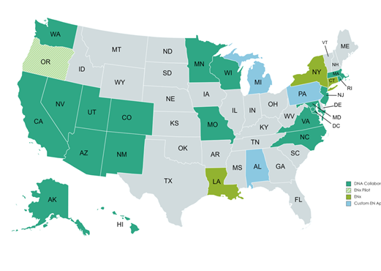












Lessons learned from Public – Private – Academic Partnership
Began as a UW / WA DOH / Microsoft Research Public – Private – Academic Partnership
Multi State Alliance (DNA) – now 16 states + District of Columbia

Slide 10

Health
Where Equity, Innovation and Engagement meet

Slide 11


FROM
Transactional
Health
TO
Transformational Health

Slide 12
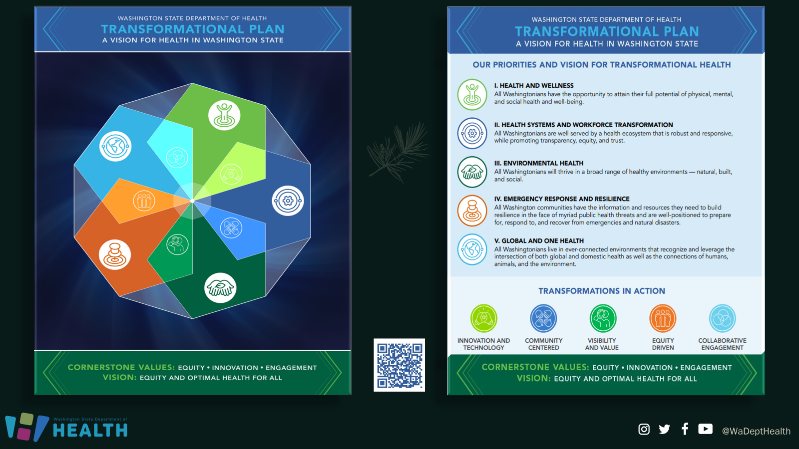
Transformational Plan

Slide 13























Washington State Department of Health
AT A GLANCE
Drinking water oversight
Emergency preparedness and response
Pesticide illness prevention
Birth and death certificates
Shellfish licensing/marine water monitoring
VISION
Equity and optimal health for all
MISSION
The Department of Health works with others to protect and improve the health of all people in Washington State.
VALUES
Our values describe who we are and who we need to become.
Equity
Innovation
Engagement
Health professional credentialing
Food safety promotion/regulation
Health care facility inspections
Radiation protection
Emergency medical services and trauma system oversight
Statewide WIC nutrition program management
HIV prevention and case management
Tobacco and vaping prevention
Injury and violence prevention
Maternal and child health support
Communicable disease monitoring/investigation
Chronic disease prevention/management
Newborn screening
Rural/urban health disparities/inequities reduction
Statewide public health data systems management
Immunization promotion
Public Health Laboratories operation
For more information about Department of Health visit www.doh.wa.gov
DOH 820-071 June 2023. To request this document in another format, call 1-800-525-0127. Deaf or hard of hearing customers, please call 711 (Washington Relay) or email civil.rights@doh.wa.gov.

Slide 14
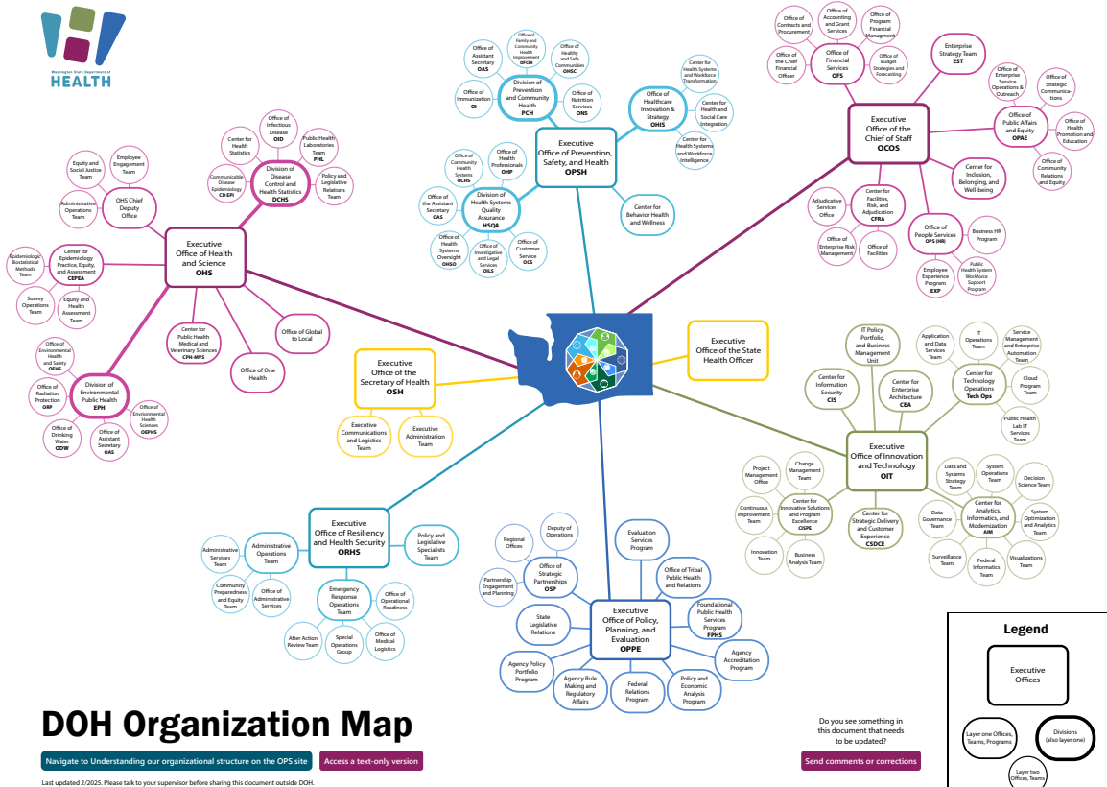

Slide 15
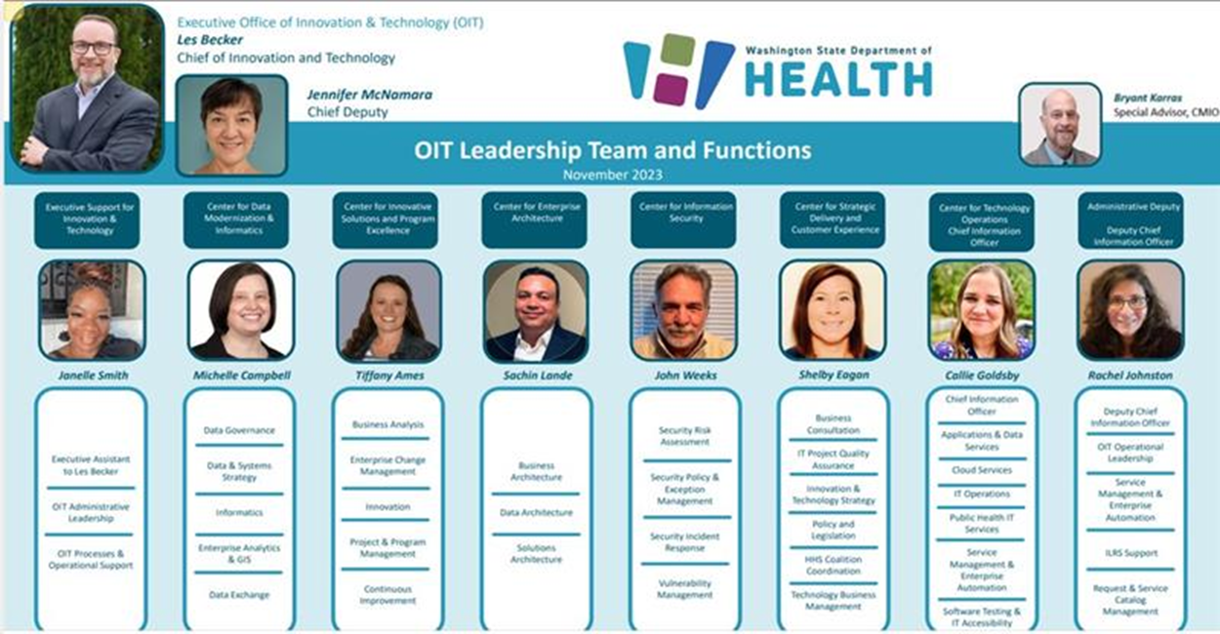
OIT Leadership

Slide 16






Data Modernization Initiative
Build the right foundation
Accelerate data into action
Develop state-of-the-art workforce
Support & extend external partnerships
Manage and change governance
Data saves lives.
Better data saves more lives.
Notes:
Public health depends on widespread and rapid access to data to drive decisions. The goal of the Data Modernization Initiative (DMI) is to move from siloed public health data systems to a connected, resilient, adaptable, and sustainable “response ready” data ecosystem that can help us solve problems before they happen and reduce the harm caused by the problems that do happen.
To overcome the challenges of modernizing our systems and better serve our communities, we have recently realigned our organization around data as a strategic asset. This shift allows us to ensure that every data-driven effort contributes directly to improved public health outcomes. ( Contributes to Building the right foundation)
For the first time, in October 2024 we established a comprehensive data strategy, built on a measurable, outcome-based goal-setting methodology that connects daily work efforts to broader strategic objectives. (Contributes to Accelerating data into action by providing visibility and transparency to our collective data modernization work)
We have leveraged assessments from the Public Health Informatics Institute (PHII) and the University of Washingtons (UW) Gap Analysis, to identify where to start and where to focus, ensuring that our modernization efforts are both intentional and impactful. This has led to the creation and iteration of a Workforce development program and beginnings of an informatics mentorship program in our center. (Contributes to Development of a State of the art workforce)
To drive transparency and alignment, we have integrated Objectives and Key Results (OKRs) across programs, projects, and portfolios, and are launching the Data@Health Steering Committee comprised of decision makers from state, tribal and local health jurisdictions. (Contributes to Supporting and extending external partnerships)
This goal setting framework ensures that every initiative—no matter how big or small—aligns to a cohesive, transparent, and forward-looking vision for public health data modernization. (Contributes to Managing change and governance)
These are just some of the many ways we’re advancing and aligning people to meet DMI outcomes.

Slide 17
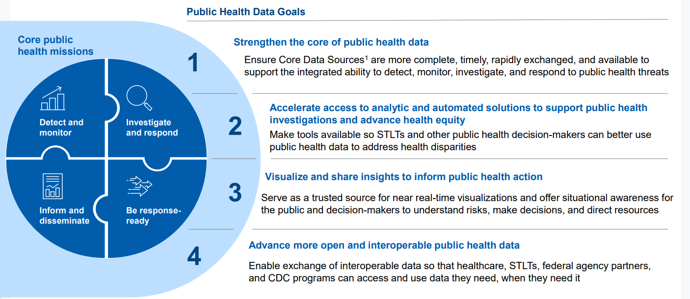
CDC Public Health Data Strategy
Notes:
As you can see this is complex work, especially given the need to coordinate across:
Federal, State, Tribal and local jurisdictions.
We’re directly supported by the The Public Health Data Strategy (PHDS) which outlines the data, technology, policy, and administrative actions essential to exchange critical core data efficiently and securely across healthcare and public health.​ It is the primary way CDC will be measuring DMI success.
The strategy is designed to describe a path to address gaps in public health data, helping the nation become response-ready, promote health equity, and improve health outcomes for all.
The CDC has been working very hard nationally not just to provide funding for state, local, tribal and territorial work but to revamp the federal infrastructure.
The CDC has recently released their amended milestones for the 2025-2026 Public Health Data Strategy, which we see direct alignment and will be navigating prioritization of efforts based on our current readiness among other data modernization efforts.

Slide 18
Data Modernization Initiative & Public Health Informatics
People
Technology
Process
People: Informatics bridges the gap between IT, epidemiology, and public health leadership.
Processes: Informaticians design and implement standardized, automated workflows.
Technology: Informaticians modernize outdated systems, enable real-time data exchange, predictive modeling, and secure public health surveillance.
Notes:
And we’re well positioned to answer the call because we’ve been investing in people with the skills to meet our modernization challenges.
Informatician or Magician?
“Any sufficiently advanced technology is indistinguishable from magic.”
Arthur C. Clarke - Science-fiction author
Public health informatics is the backbone of data modernization—it ensures that data is not only collected but also transformed into actionable insights that drive decision-making, policy, and public health interventions.
PHI Fills Critical Gaps we have that are barriers to successful Modernization work
1. Standardizing and Integrating Public Health Data
Public health data comes from multiple sources (e.g., hospitals, labs, clinics, community health programs) in different formats, many of which are not designed to work together.
Informatics professionals bridge this gap by implementing data standards (FHIR, HL7, etc.), interoperability frameworks, and governance models that allow for seamless data exchange.
2. Improving Data Timeliness and Quality
Many public health systems rely on manual data entry, outdated formats (PDFs, spreadsheets), and fragmented databases, leading to delays and inconsistencies.
Informatics professionals automate data flows, implement real-time reporting mechanisms, and design systems that ensure accurate, up-to-date information reaches decision-makers faster.
3. Enhancing Public Health Surveillance and Analytics
Without informatics, public health surveillance relies on delayed or incomplete data, making it difficult to track emerging health threats.
Informatics enables predictive analytics, machine learning models, and data visualization dashboards that help epidemiologists and policymakers respond proactively rather than reactively.
4. Strengthening Data Governance, Security, and Compliance
As public health shifts toward cloud-based platforms and integrated data ecosystems, privacy, security, and governance risks increase.
Informatics professionals ensure HIPAA compliance, cybersecurity best practices, and ethical data use policies, protecting both public health data and the communities it serves.
5. Training a Future-Ready Public Health Workforce
Many public health professionals lack formal training in data science, analytics, and modern informatics tools.
Informatics professionals provide technical expertise, workforce development, and capacity-building programs to ensure that modernization efforts are sustainable.

Slide 19











Data Modernization Milestones
Nov 2020 Public Wa Notify
January 2021
March 2020 Google Apple UW CSE proposal
CEDAR Project kicked off Master Person Index (MPI) Project kicked off
Feb 29 2020
Gov Inslee – Emergency Declaration
July 2022
Center for Data Modernization & Informatics established
April 2022
DMI assessment & gap analysis complete
August 2022
Data and Systems Workforce Training Pilot Project kicked-off
December 2022
CLOUD 2.0 Project &
Enterprise-wide Data Governance Project
September 2022
Data and Systems Modernization 5-Year Plan developed White House OSTP Visits
Notes:
Les:
Prior to the COVID pandemic, Washington state made progress towards modernizing our data systems and infrastructure.
We had already:
assessed the current state of our data systems and infrastructure,
established the “Data@Health program,
planned our first PaaS implementation, AND
begun conversations with partners to address gaps in health data linkages through a statewide Master Person Index solution
Over a year into the pandemic, issues with data systems, infrastructure, and processes continued across the nation. To understand gaps in Washington state, we partnered with University of Washington to conduct an analysis and develop a 5-year Data and System Modernization plan.

Slide 20
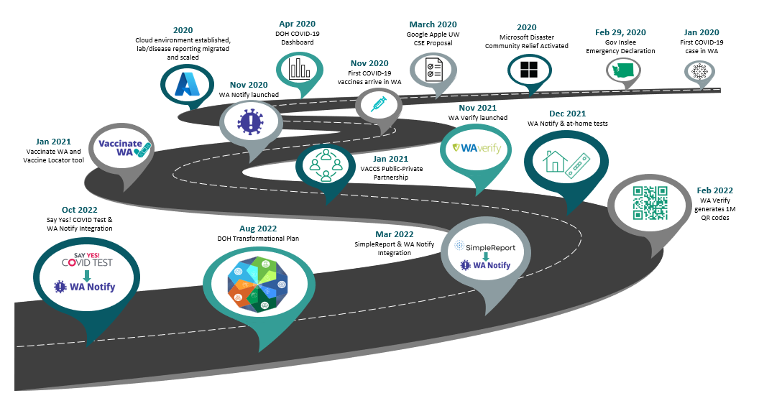
Data Modernization Initiative Milestones on the Road
Notes:
WA is adjusting to a new Gov Admin and $12B budget deficit combined with the natural ramp down of Fed covid funds. Managing that requires some pause/holds and reprioritization in the near term and realignment of many activities...

Slide 21
Our Vision
Washington State Dept. of Health
Advance
Advance inter and intra-organizational interoperability with reusable building blocks.
Un-Silo
Break down data silos and create data linkages between different programs in DOH.
Standardize
Standardize public health data with a common data model for exchange internally and externally with the use of HL7 FHIR, on a need basis where it demonstrates business value.
Compliance
Meet federal, state, and local HL7 FHIR requirements and contribute, as a leader, to public health FHIR initiatives.

Slide 22
Method
Development of Roadmap
The objective was to identify and remove gaps in the infrastructure in order to efficiently exchange data with its existing and potential future data partners and in accordance with the 21st Century Cures Act and Information Blocking Rule.
Needs of Public Health including analysis of programs, State and Federal mandates, as well as current and potential future use cases were evaluated.
Roadmap was drafted after analyzing the DOH IT infrastructure.

Slide 23
Method (cont.)
Landscape analysis
A landscape analysis was done simultaneously to understand all the different products and services being offered by different vendors in the FHIR community.
Five different products – Smile Digital, Aidbox, Firely, Azure Data Services, and HAPI FHIR were shortlisted for further research based on their popularity and use in the FHIR community.
A thorough evaluation was done on the capabilities of each of the products mainly under three broad categories - features set available, system performance, and pricing.

Slide 24
Infrastructure: Major Components
Data consumption endpoints
Data exposure endpoints
System for processing data and storage/shipping to respective data owner systems
Data transformation pipelines
User Interface development tools

Slide 25

FHIR Roadmap
Step 1: Development of Common data collection capabilities
Utilizes the common data model in FHIR
Uses FHIR service, Rhapsody interface engine and data processing pipelines
Step 2: Development of Data Processing Pipelines
Data transformations needed
Data assets curation and provisioning (in collaboration with Data Science team)

Slide 26
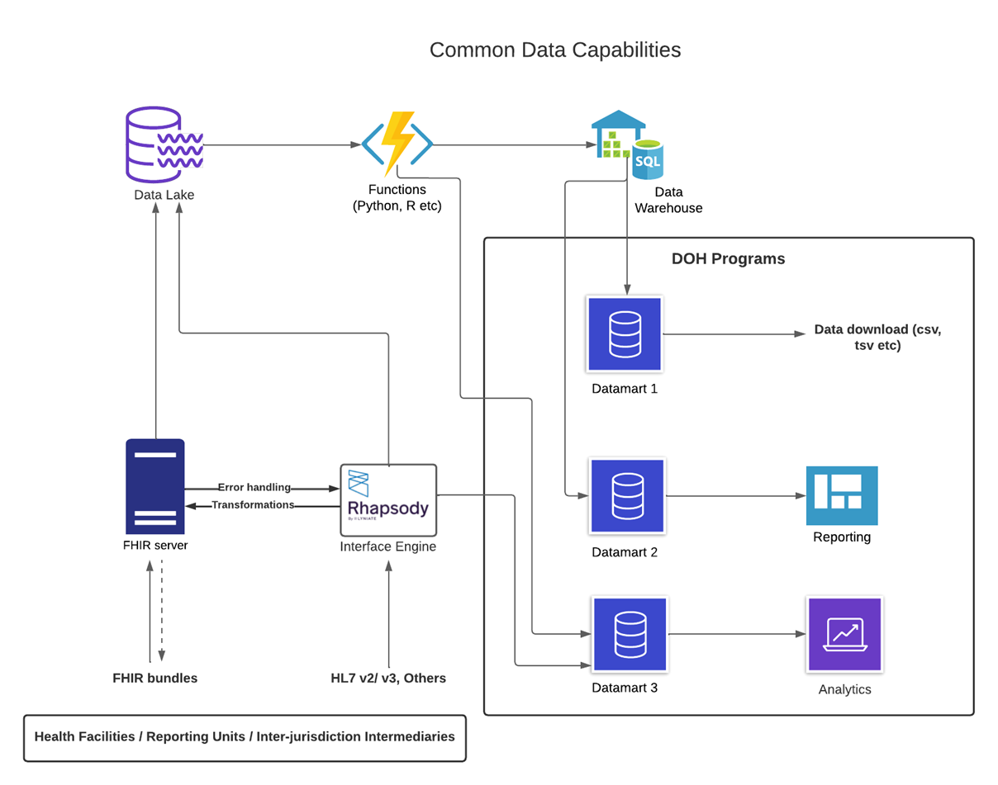
FHIR Roadmap: High Level
Notes:
This slides depicts how DOH plans to process the data and package/provision them in different forms for the respective program teams to use based on their need
This is a generalization of the service that will be provided to the program teams.

Slide 27
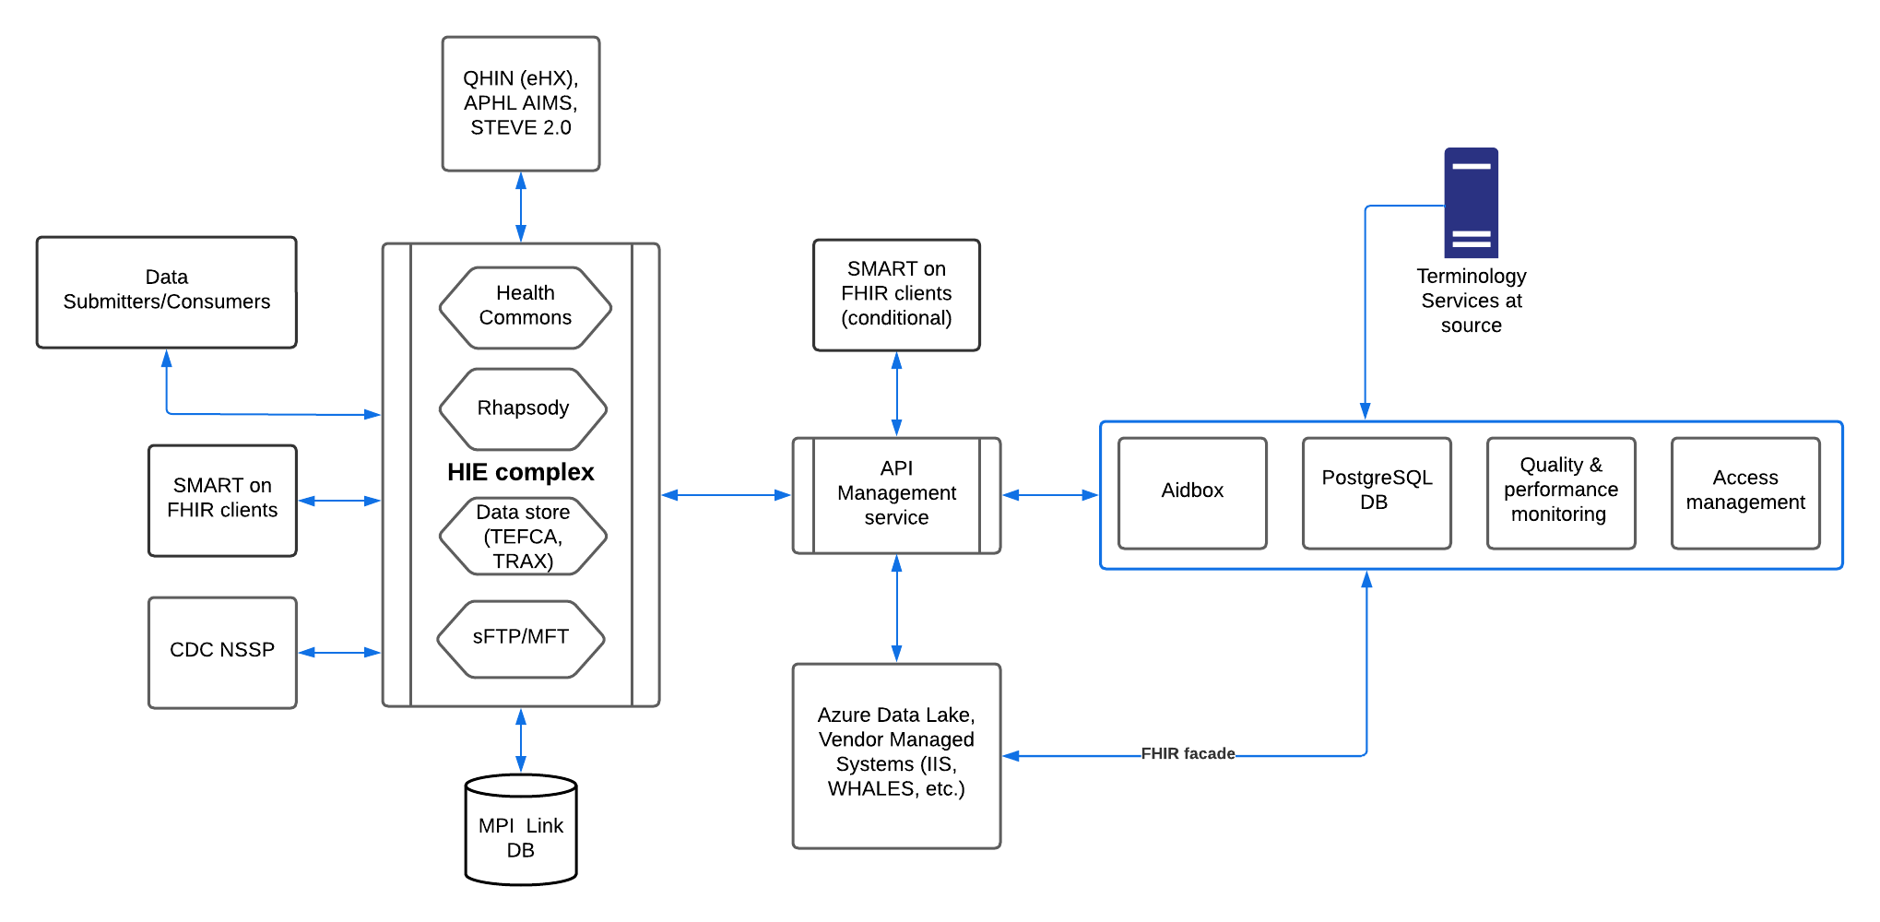
FHIR Adoption Process Flow
Notes:
It delves more on the different components of FHIR infrastructure and how that blends/interacts with the other components of DOH IT infrastructure
It also describes the process flow from a higher level

Slide 28






Washington State Department of Health’s FHIR Ecosystem
SMART on FHIR app for PDMP: COSRI - Clinical Opioid Summary with Rx Integration
Installed in providers EMR or stand alone
WA Health Summary with SMART Health Links
Portable International Patient Summary (IPS)
WA Health: Hospital Capacity – SANER / SAFR – Situational Awareness
Helios innovation and standards development
Death data - Vital Records Death Reporting
PHFIC State and Local partnership with NCHS in adoption of FHIR
Co-Propel Birth Records & Newborn Screening (NBS)
Communicable Disease Surveillance (eCR)
Chronic Disease Population Level Monitoring (TRAX)
Immunization Information System Bulk Data Exchange

Slide 30
WA HEALTH
Washington’s Healthcare Emergency And Logistics Tracking Hub
Provides state-wide view of:
Hospital capacity for acute care, ICU, and surge beds
Ventilator availability
Supplies & PPE
Influenza & RSV Statistics
The Situational Awareness Platform for DOH
Future capabilities: Behavioral Health, Automated Reporting (FHIR), Near real-time bed capacity, BH bed registry
Other conditions/emergency situations' victims tracking (wildfire, flood, hurricane, tornadoes etc.)​
Notes:
WA HEALTH’s mission is to operate and enhance a technology platform that collects key health care data to help leaders make timely and informed decisions in response to public health threats.
NEED: SANR and SAFER from Ravi

Slide 31

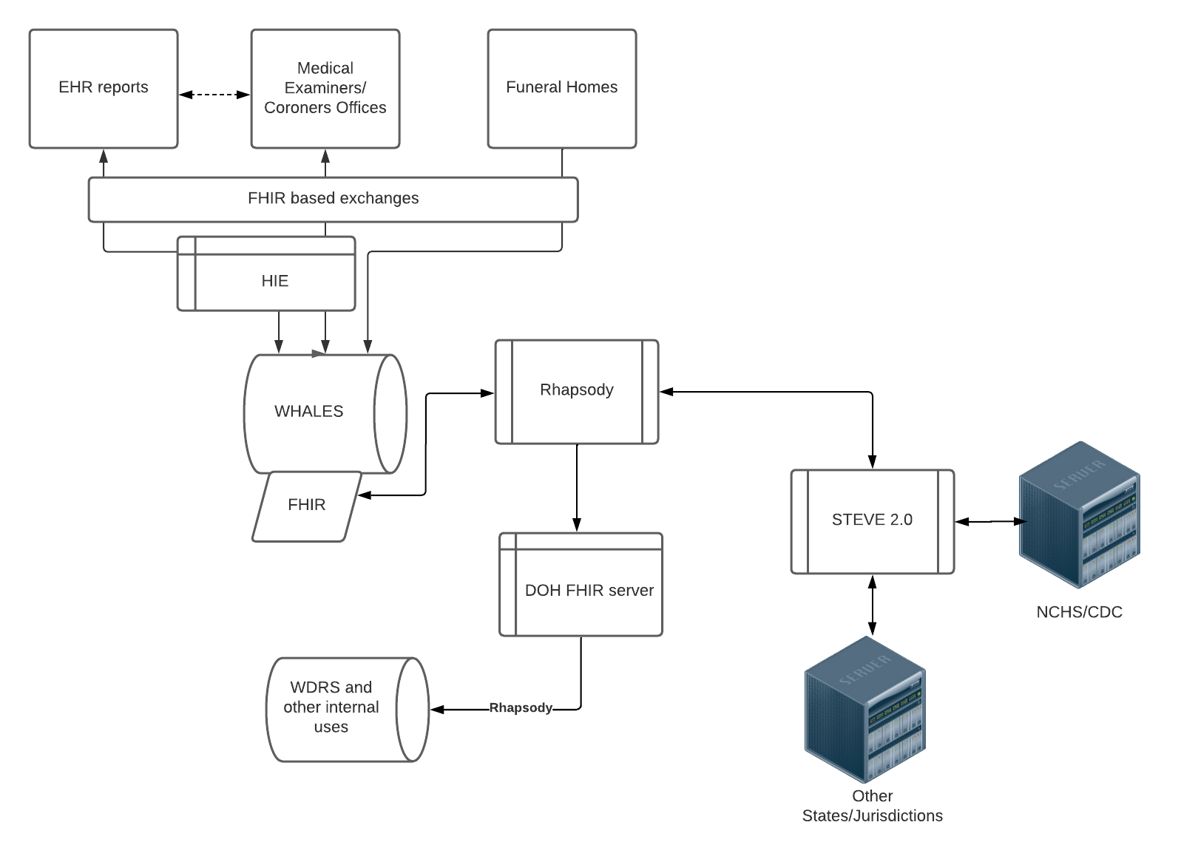
Vital Records Death Reporting
Three Phase FHIR Pilot
Phase 1: Sending death record data from DOH to PHSKC
Phase 2 : Death investigation data from PHSKC to DOH
Phase 3 : Bulk Immunization Lookup
Notes:
Exchange of data standardized with HL7 FHIR and exposed with REST APIs has great potential for breaking data silos:
Between different programs in DOH
Between the State and the LHJs
Between public health and health care systems
Death data interoperability with disease registries could be a 'plug and play' between systems rather than putting manual efforts for data merging and performing analytics e.g. Condition specific death rates

Slide 32

1
Improved Data Sharing
TEFCA can enable seamless data exchange between healthcare systems, allowing real-time reporting of respiratory illness cases.
2
Reduced Administrative Burdens
By automating data sharing, TEFCA reduces the administrative workload on healthcare providers who otherwise must manually report case details.
3
Timely Public Health Decision Making
With faster and more comprehensive data access, public health authorities in Washington State can make more informed decisions, respond quickly to potential outbreaks, and allocate resources more effectively.
Notes:
The Trusted Exchange Framework and Common Agreement (TEFCA) is a federal initiative designed to facilitate secure, interoperable exchange of electronic health information across healthcare organizations nationwide. By connecting different QHINs, TEFCA ensures that critical patient data can be shared seamlessly, regardless of the systems used by individual providers.
By utilizing TEFCA, the Washington State Department of Health can make notable improvements to the RESP-NET surveillance system processes and data.

Slide 33
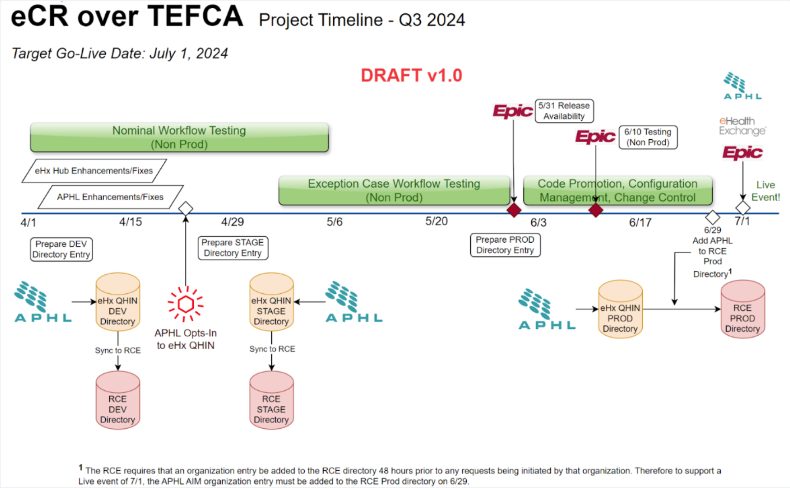

Slide 34
CURRENTLY: Process to get laboratory and healthcare patient data from healthcare facilities to LHJs and then to Washington Disease Reporting System is manual and time intensive.
GOAL: Reduce the manual load on healthcare facilities, LHJs, and WA DOH while increasing efficiency and analytic capabilities.
WA DOH and King County are piloting an automated system for querying Qualified Health Information Networks (QHINs) under the Trusted Exchange Framework and Cooperative Agreement (TEFCA) using Skylight’s Query Connector.
Notes:
The Respiratory Virus Hospitalization Surveil-lance Network (RESP-NET) is a CDC-sponsored network of 13 U.S. states that monitors laboratory-confirmed hospitalizations associated with:
• Influenza
• Respiratory Syncytial Virus (RSV)
• COVID-19
RESP-NET sites gather data from laboratory and healthcare facilities to understand trends in virus circulation, estimate disease burden, and respond to outbreaks. The data collected by RESP-NET sites allow disease severity comparisons across seasons, states, and demographic groups.
In WA state data about laboratory-confirmed hospitalizations associated with influenza, RSV, and COVID-19 come from:
• Statewide syndromic surveillance of hospital admissions due to respiratory viruses
• Electronic Laboratory Reports of laboratory-confirmed cases
• Healthcare facility lists of hospitalized patients
• LHJ investigation of cases

Slide 35

GOAL: Develop a “minimum loveable product” (MLP) for TRAX data exchange and analytics.
Three Phases:
Phase 1: Build on Multicare’s current FHIR Infrasture (eCR Now FHIR App)
Automate data extracts – Diabetes, Hypertention
Phase 2 : Leverage existing PH data visualization and querying tools to produce analytic products
MENDS ESP Software
Phase 3 : Engage additional healthcare provider organizations to submit data
Use Master Person Index for de-duplication
Notes:
The WA Healthcare Forum Board and WA Department of Health (DOH) leadership asked staff to convene a work group to improve chronic disease surveillance in Washington state
Work group = Forum member reps, DOH, and OneHealthPort (state HIE)
-Met monthly during 2023/2024 with focus on…
Providing health care and public health professionals with more timely, actionable chronic disease surveillance information
Potential for a shared system with shared data & governance
Recognition that better chronic disease surveillance would be useful for our state.
People with chronic conditions – often multiple chronic conditions – are your most complex patients.
Chronic conditions like hypertension and diabetes are among most common conditions we deal with in the US healthcare system

Slide 36







Data Partners
Data Pipelines / Data Use Agreements
MultiCare Connected Care
Data submitter
Association of Public Health Labs
eCR Now FHIR App
eHealth Exchange
Verbal agreement
Already has connections to MC and CRISP
Minimum Loveable Product Partners
Master Data Management
Data Analytics
CRISP Shared Services / State HIE
Very interested/exploring
.
CRISP Shared Services / State HIE
Very interested/exploring

Slide 37
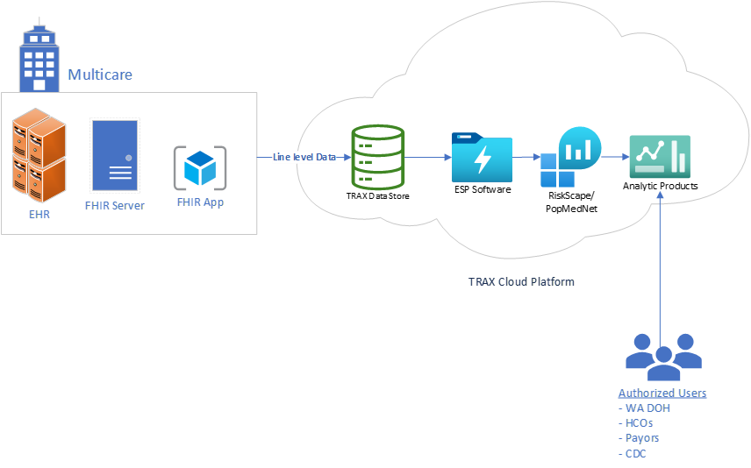




Phase II

Slide 38



Birth Records & Newborn Screening (NBS)
Three major activities:
Short-team follow up data to get clinical diagnostic data to NBS program for case close-out
Defining business case
Finalizing data use agreement
Investigating Query Connector Tool, Direct Connect to hospitals vs. eHealth Exchange
Long-term follow-up(LTFU) data
Action steps: Will build on activities of LTFU Work Group and lessons from short-term follow-up interoperability work
Birth Notification – ensure every baby has received a screen
Action Steps: Define business case and identify needs

Slide 39
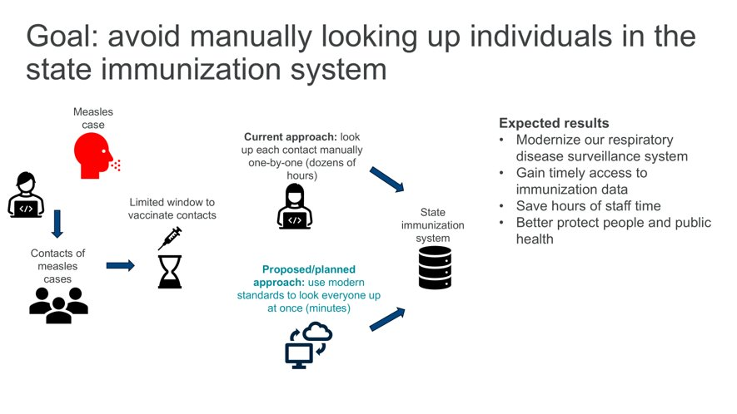
Immunization Information Systems Bulk Data Exchange

Slide 40


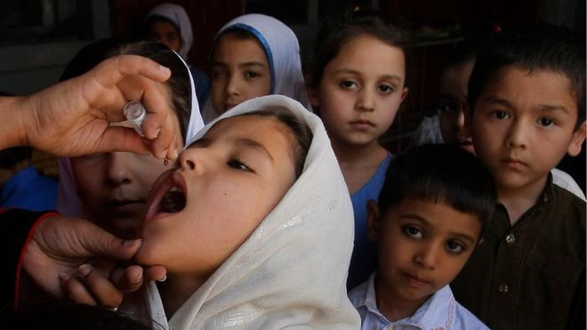

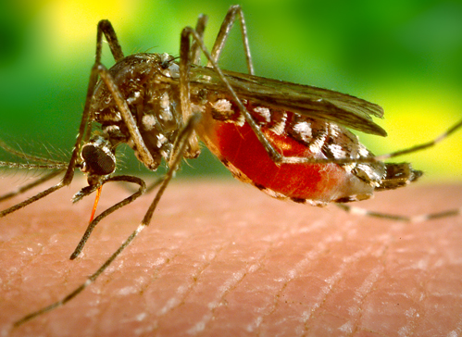

Public Health Challenges and Solutions Do not Recognize Borders

Slide 41
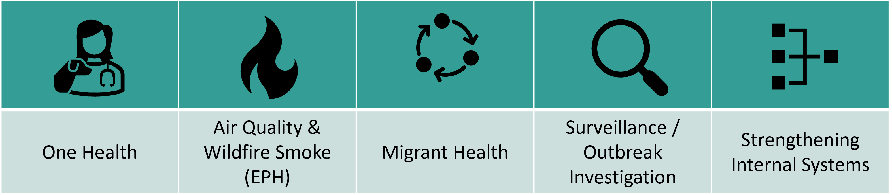
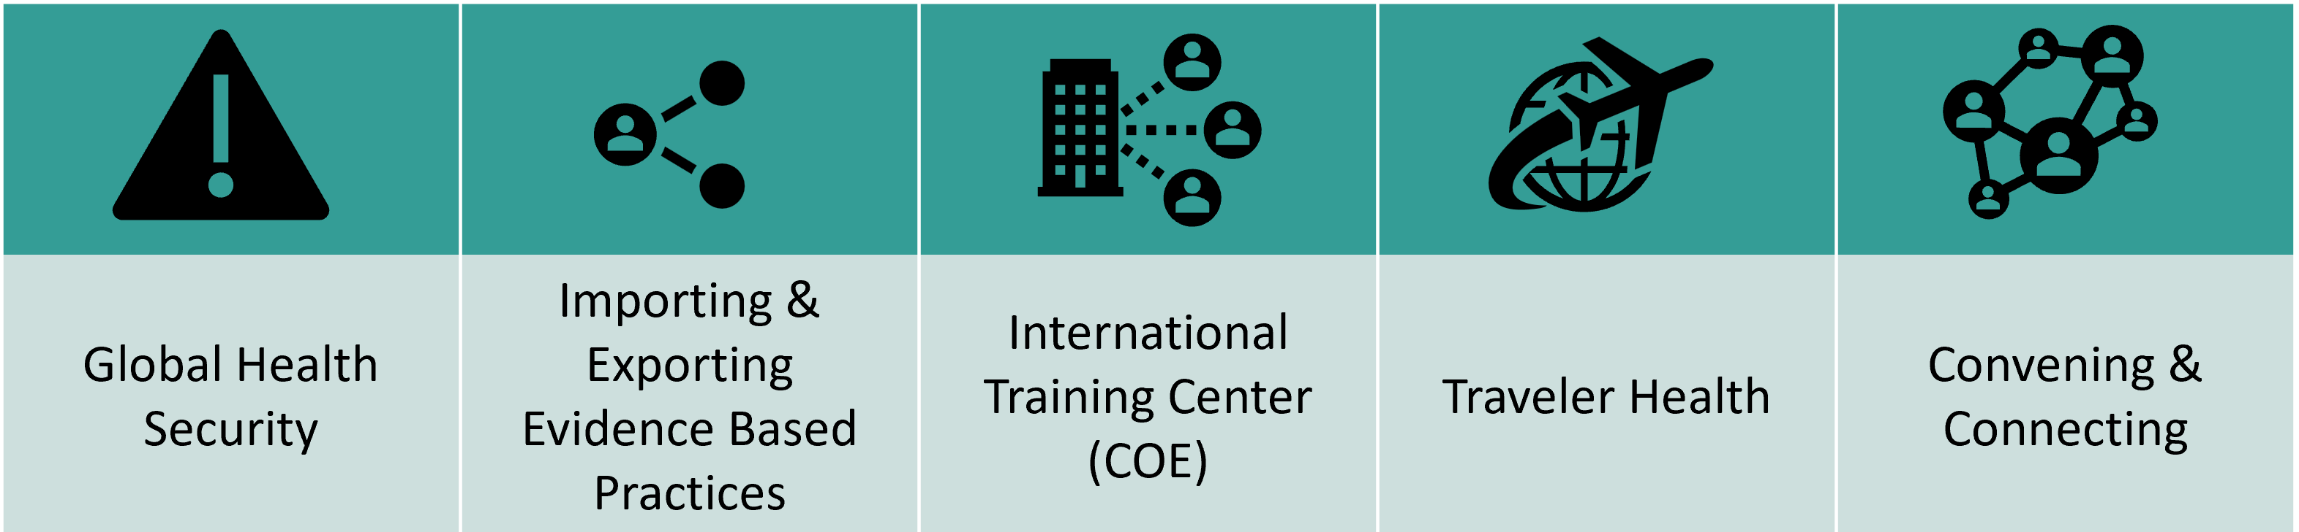


State of Global and one Health work within DOH
Current state
Future state
@WaDeptHealth
1

Slide 42

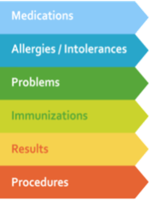


WA - Health Summary (WA Verify+)
Utilizing the International Patient Summary (IPS)Standard
Patient directed key verifiable clinical data for travel
Embedded URL in a QR code that links to data and/or FHIR endpoints
Patient Summary Demo Link

Slide 43
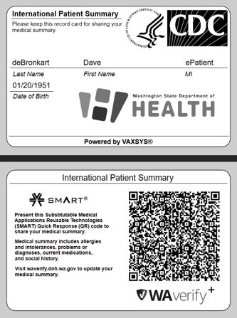



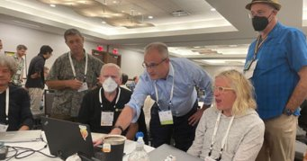
Empowering Patients with their Data
Notes:
In 2008, Casey Quinlan was diagnosed with breast cancer ​
“Some doctors have misunderstood their place in the doctor-patient relationship. We’re partners in our care. People – again - the ones called “patients” in this party, are not worshipers at the altar of medical professional knowledge, nor are we lesser beings because we don’t have MD behind our names…you’re the partner in your own care” ​
“Why did I do this? Because I’ve been waiting for the medical-industrial complex to deliver on their promise of health information exchange (HIE), the promise that they’ve been making for years, but have yet to fork over” (2015 QR Code Tattoo)​
She passed in hospice on April 25, 2023​

Slide 44
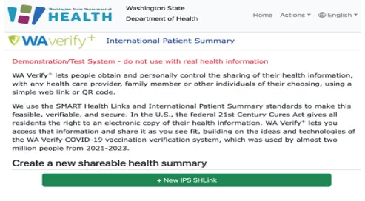
Multiple Methods for Access and Storing
SMART Authorization​
Epic​
Oracle/Cerner​
MEDITECH​
FHIR URL​
FHIR Bundle​
TEFCA Query

Slide 45


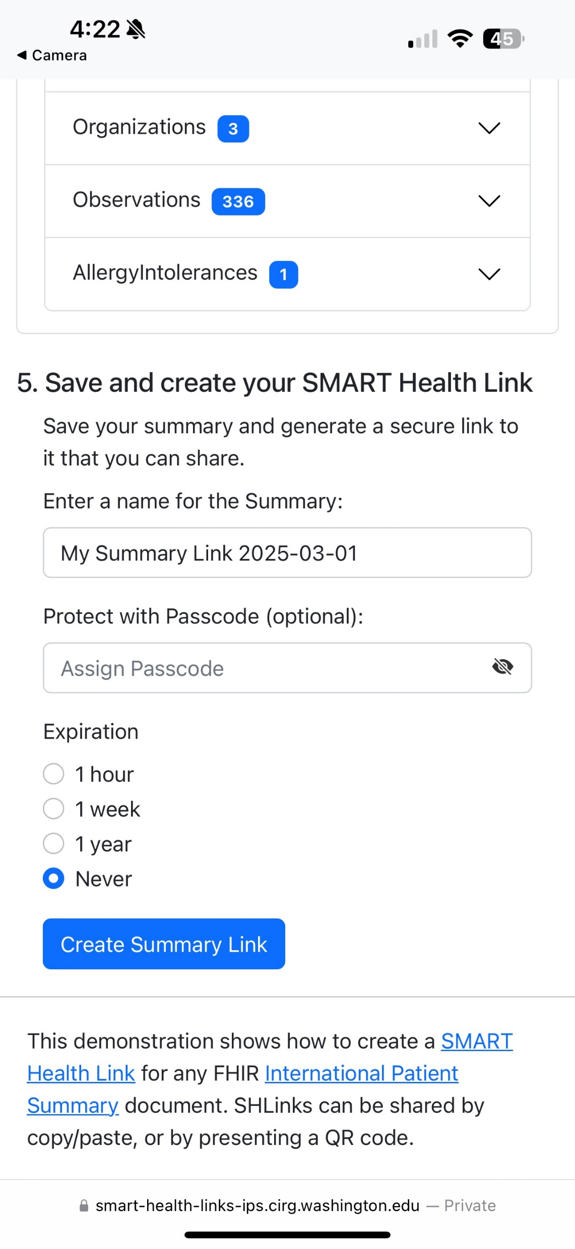
Mobile Health Summary
1
Patient Controlled
Each method of access provides a selection for expiration duration – 1 hour, 1 week, 1 year, Never​
2
Verifiable & Secure
SMART Health Link can be passcode protected for additional security.
3
Manage Dependent Records
Health data from dependents/children accessible under the same Link/QR Code

Slide 46
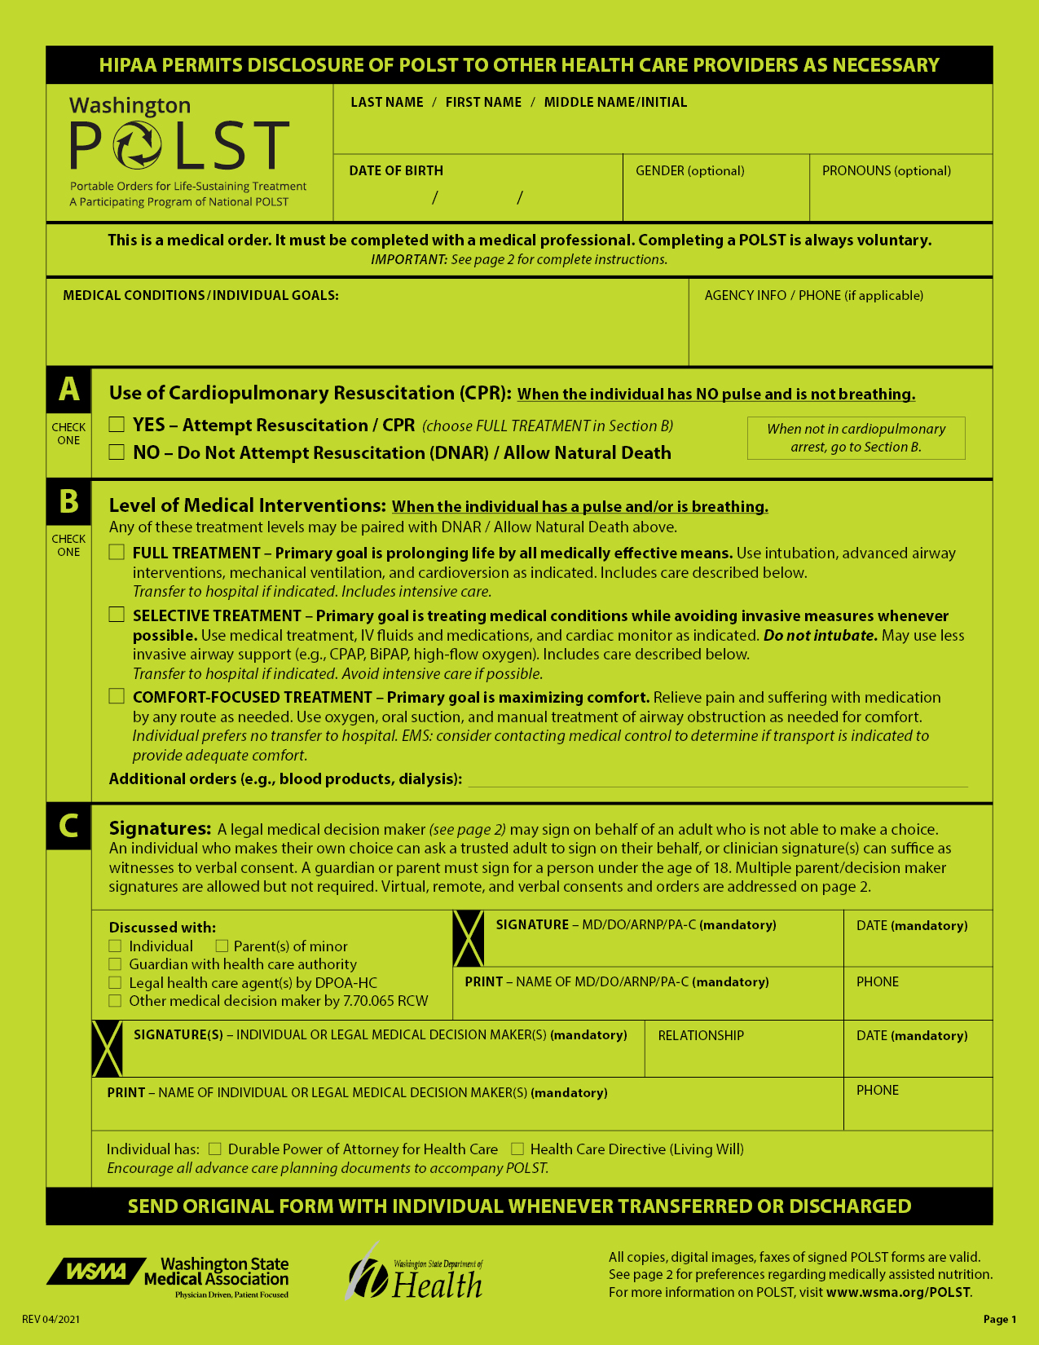

Portable Orders for Life Sustaining Treatments
Moving from paper forms to digital portable wishes
POLST
Advanced Directives
MHAD
Power of Attorney
Participating in HL7 standards development
Currently in WA legislative process
HB 1724
Notes:
Add paper form image
Budget Proviso to explore creation of a registry for these forms
Environmental Scan (Partner: UW SoPH)
Peer Review Literature (32 articles)
Official Reports (from other states)
Met with 7 states to learn
Request for Information (Registry)
Hope to release this month
Recommendations to Improve Proposed Legislation
Digital Submission Only
Mandatory Provider Submission
Broaden registry to cover all types of advanced directives
POC for reuse of WA-Verify for Portable Medical Orders (Partner: UW CIRG)
Connect-a-thon Testing
Work with PACIO HL7 WG

Slide 47




















Public-Private-Academic Partnerships
Notes:
Multicare, Epic, CRISP, Meditech

Slide 48















































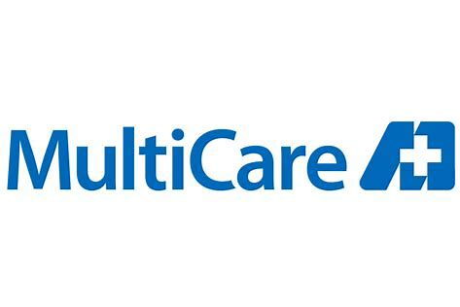

Importance of Strategic Partnerships

Slide 49


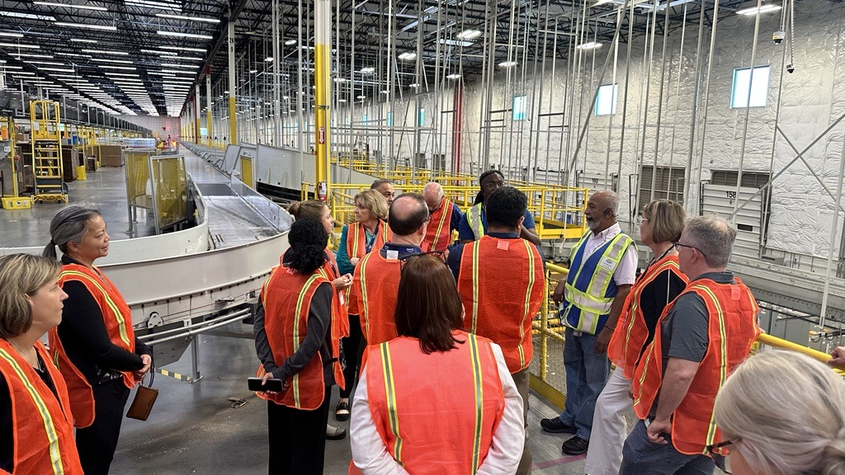
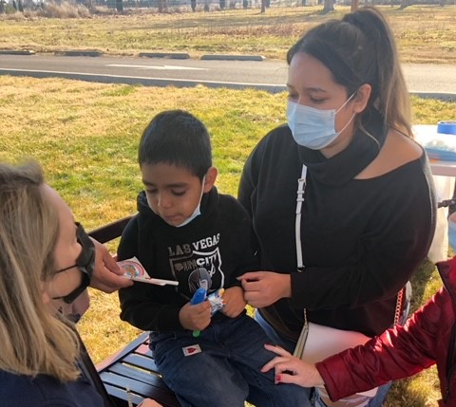
Health in WA Moving Forward
Transformational Health
Investment/Workforce
Behavioral Health/FOCUS Taskforce
Digital Health/Tech
Climate and Health
Social Drivers of Health
Healthcare Delivery/Access to Care
Respiratory Season Response
Notes:
Right now we are focused on five health priorities, recognizing that there are a myriad of health issues public health departments are focused on.

Slide 50



“Our hope is that together we will not just move forward, but we will thrive and transform our system of health in Washington and be a model for others — where together we create the reality that everyone across Washington has the opportunity to live the healthiest of lives. The work has only just begun but this moment marks the beginning of this road.”
∞
Thank you for partnering with us on this journey — together we can and will make a difference.
To learn more: https://doh.wa.gov/about-us/transformational-plan
@WaDeptHealth
1

Slide 51
Questions
Use this slide for Q&A at the end of your presentation
Remind attendees to complete an online evaluation for your session

Slide 52


Thank You
Contact Information:
Bryant Thomas Karras, MD FACMI
Chief Medical Informatics Officer
www.doh.wa.gov/healthit
Bryant.Karras@doh.wa.gov
BKarras@UW.edu

